Slide 1
Resteasy Food order system
A. Anasuya Threse Innocent

Slide 2
RestEasyFoodOrder
RestEasyFoodOrder project is an online Food Ordering system built using Spring Boot, MYSQL for Database, and Hibernate Framework.
This project is developed for an hassle free online ordering of food.
The main motive of this application is to manage the food items, with its calorie value so that the customer can order it health consciously.
This project has both Customer and Admin access where Admin can add the food items and the Customer can view in sorted items with their calorie value, and order them using this application.

Slide 3
Problem Statement
RestEasyFoodOrder is an online food ordering web application. Below are the set of requirements to be fulfilled.
1. As a customer, I should be able to Login to the application
2. As a customer, I can view either the list of Food vendors or search by dish
3. As a customer, I should be viewing a list of all the vendors (Food vendors)
4. As a customer, I should be able to view the dishes.
5. As a customer, I should be able to sort the dishes by price (both ascending and descending)
6. As a customer, I should be able to add the quantity
7. As a customer, I can order many dishes along with quantity
8. Each order will contain the below fields
9. Each Order will container 1-N OrderLineItems.
10. Each Order Item can be from different vendor
11. Each Dish should contain Name, calories fields
12. A Dish can be sold by different vendor with different price. Only the name and calories will be
same across the vendors.
13. The admin should be able to view all the orders and sort based on order amount and order
date.
14. Below mentioned features are out of scope
a. Authentication and Authorization
b. Order Payments and payment gateway Integration
c. Assume orders submitted are payed by the customer
d. UI (Should be CLI based)
15. Any feature missing above can be interpreted by the participant as needed

Slide 4
Modules and Functionalities
Admin
Add /Update/Delete Vendor
Add/Delete Customer
ViewAll orders
Sort based on order amount
Sort based on order date
Vendor
Add/Update/Delete Dish details
Customer
Login (first time register)
View list of food vendors
Search by dish
View the dishes
Sort dishes by price
Ascending
Descending
Add/Update/Delete quantity
Order many dishes with quantity
Order specifications
Contains 1-N OrderLineItems
Each order item can be from different vendor
Each dish contains Name, Calorie fields
A dish can be sold by different vendor with different price, but Name and Calorie should be the same

Slide 5
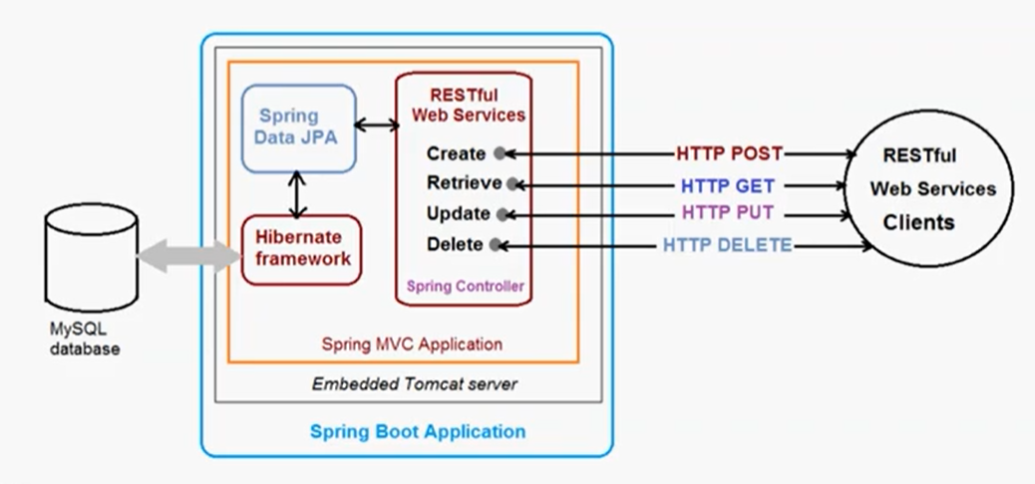
Application Framework
Spring Boot RESTful Web Service CURD API

Slide 6
Tools & Technology Used
Technology/Domain: Java (JDK 1.8+)
Frameworks: Hibernate, Maven
Server-side: Spring Boot
Back-end: MYSQL
Server: Tomcat 9.0.52
IDE: Eclipse IDE 2020-12
Test Tool: Postman

Slide 7
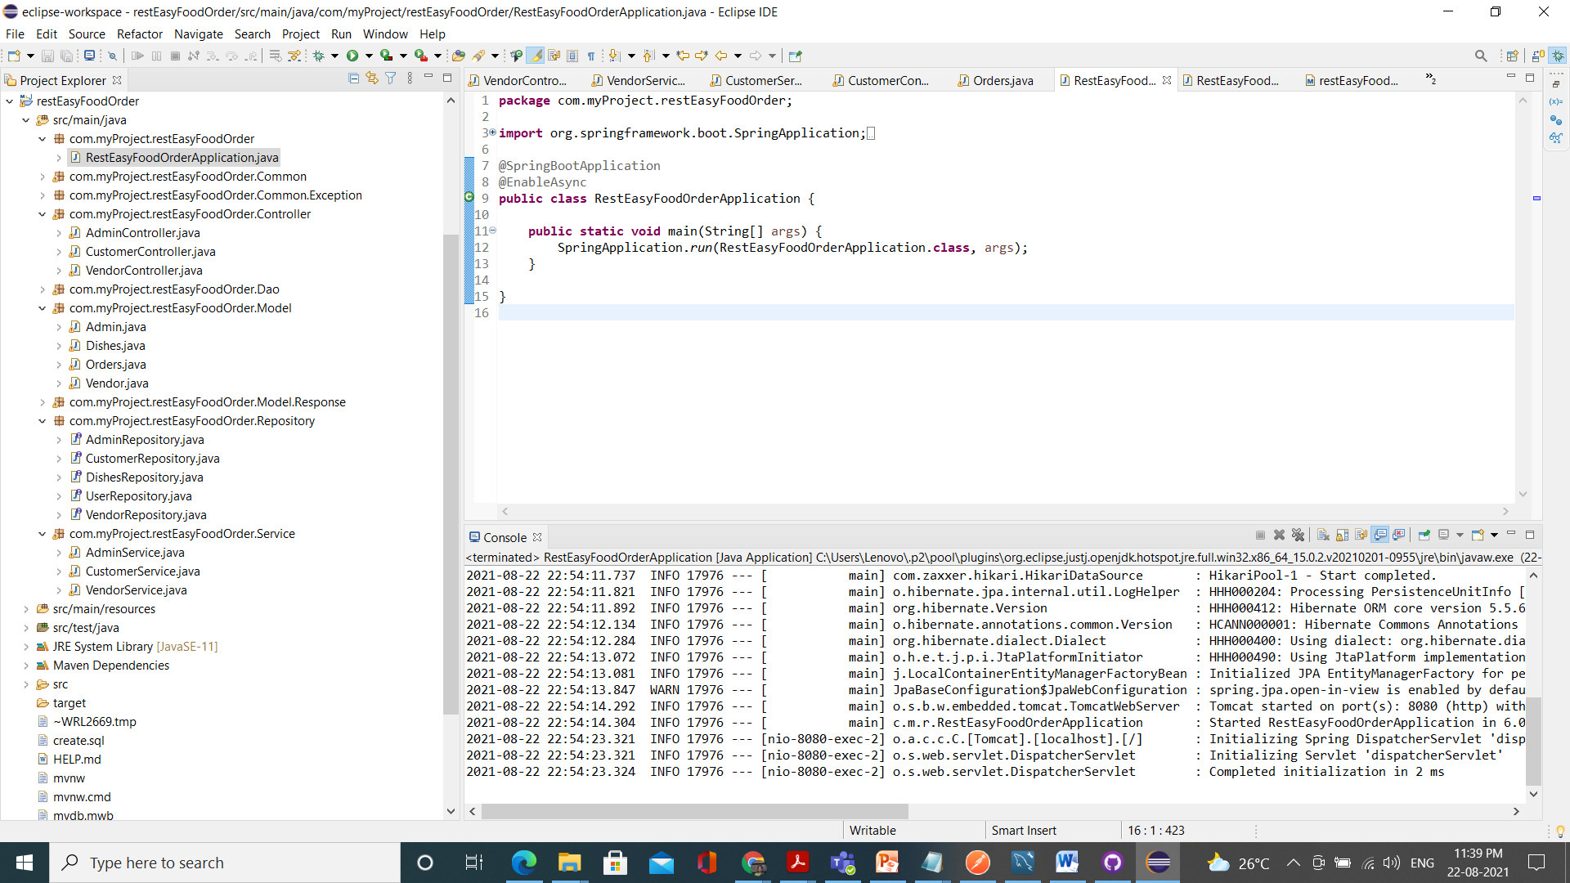
Project Structure

Slide 8
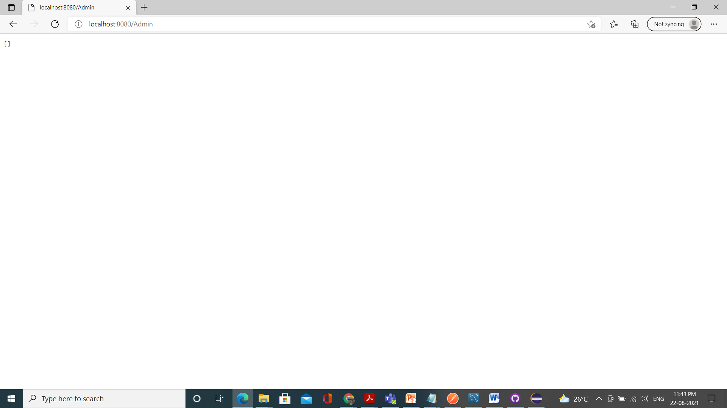
Sample Screenshots
Admin → list orders → empty list as there are no orders
http://localhost:8080 is used

Slide 9
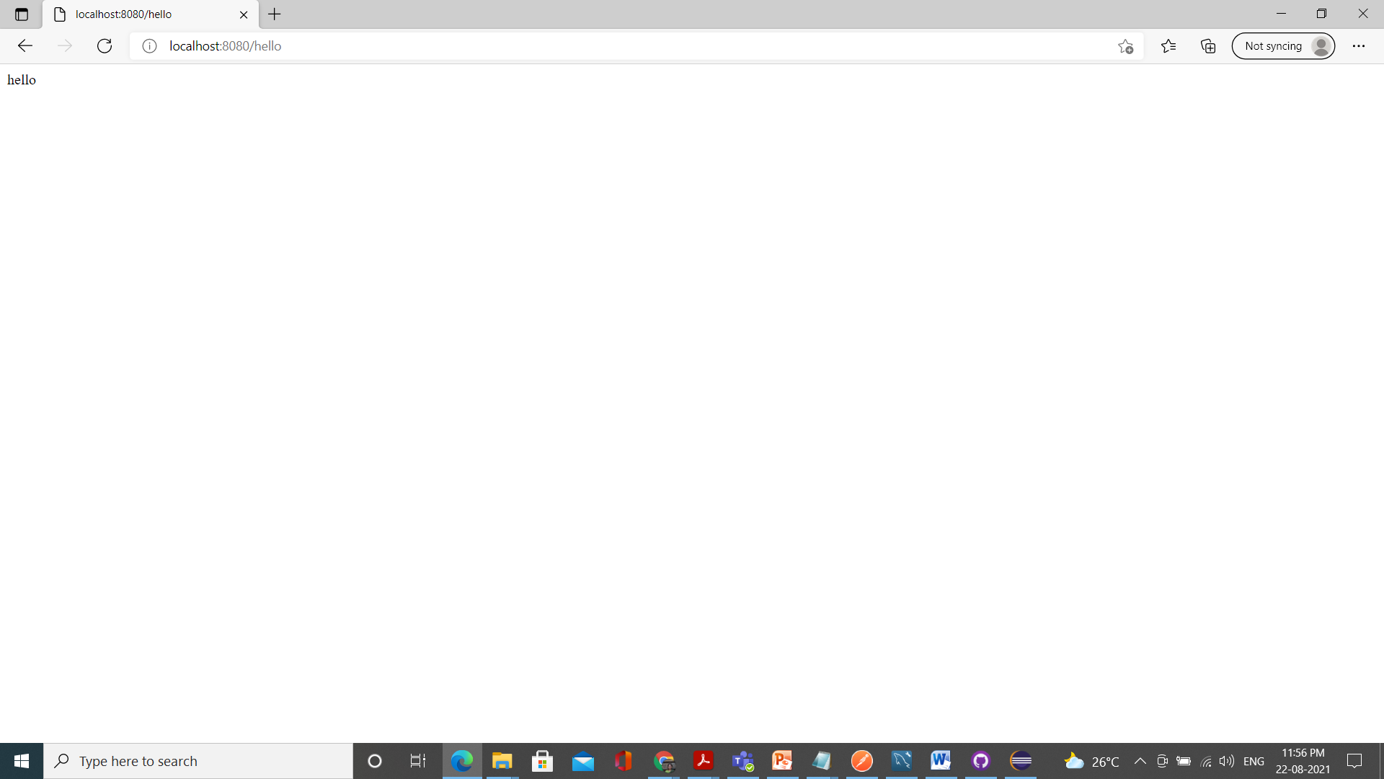
Welcome

Slide 10
GET methods can be accessed through website with the localhost

